Slide 1
Introduction to Stored Procedures

Slide 2
What is a Stored Procedure?
Stored Procedure In SQL server can be defined as the set of logically group of SQL statement which are grouped to perform a specific task. There are many benefits of using a stored procedure
A stored procedure is nothing more than a prepared SQL code that you save so that you can reuse the code over and over again.

Slide 3
Benefits of using Stored Procedures
Benefit | Explanation
Modular Programming | You can write a stored procedure once, then call it from multiple places in your application hence reducing development time It can accept input parameters, return output values as parameters, or return success or failure status messages
Performance | Stored procedures provide faster code execution Reduced network traffic
Security | Users can execute a stored procedure without needing to execute any of the statements directly Users can specifically be granted permission to execute only Stored procedures instead of allowing them to execute queries on tables directly.
Notes:
Faster execution: Stored procedures are parsed and optimized as soon as they are created and the stored procedure is stored in memory. This means that it will execute a lot faster than sending many lines of SQL code from your application to the SQL Server. Doing that requires SQL Server to compile and optimze your SQL code every time it runs.
Reduce Network Traffic: If you send many lines of SQL code over the network to your SQL Server, this will impact on network performance. This is especially true if you have hundreds of lines of SQL code and/or you have lots of activity on your application. Running the code on the SQL Server (as a stored procedure) eliminates the need to send this code over the network. The only network traffic will be the parameters supplied and the results of any query
Security: Therefore, a stored procedure can provide advanced database functionality for users who wouldn't normally have access to these tasks, but this functionality is made available in a tightly controlled way.

Slide 4
Stored Procedure vs. SQL Statement
SQL Statement
Stored Procedure
Creating
Check syntax
Compile
First Time
- Check syntax
Compile
Execute
Return data
First Time
Execute
Return data
Second Time
- Check syntax
Compile
Execute
Return data
Second Time
Execute
Return data

Slide 5
Syntax for creating/executing Stored Procedure
Creating Stored Procedure:
CREATE PROCEDURE dbo.procedure_name
AS
BEGIN
(SQL Query)
END
Executing Stored Procedure:
EXECUTE dbo.procedure_name

Slide 6
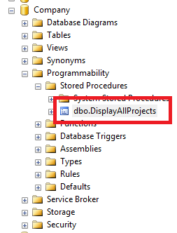
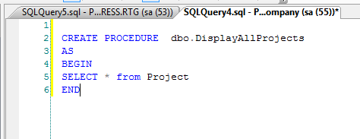
CREATE a Stored Procedure
Successfully

Slide 7
Variables in Stored Procedures
Declare a variable:
DECLARE @limit money money;
DECLARE @firstName varchar(10),@hi_range varchar(10);
Assign a value into a variable:
SET @limit money = 0;
select @firstName = ’ABC’, @hi_range =‘XYZ’;
->Cannot assign value to 2 variables using SET
Assign a value into a variable in SQL statement:
SELECT @price = price FROM titles WHERE title_id = 'PC2091'

Slide 8
Types of Stored Procedures
Type | Explanation
Stored Procedure (without parameters) | The created procedure has no parameter and simply returns the result of query.
Stored Procedure (with parameters) | The real power of stored procedures is its ability to accept parameters and return results based upon those parameters.

Slide 9
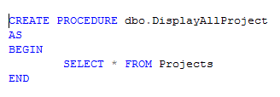
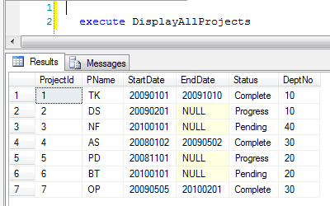

Stored Procedures (with out Parameters)
Creation:
Execution:

Slide 10
Syntax for creating/executing Stored Procedure with parameters
Creating Stored Procedure:
CREATE PROCEDURE dbo.procedure_name
@input_param1 varchar(10),
@input_param2 int,
@output_param1 int OUTPUT,
@output _param2 datetime OUTPUT
AS
BEGIN
(SQL Query)
END
Executing Stored Procedure:
declare @my_output_param1 int,@my_output_param2 varchar(10)
Exec dbo.procedure_name
@input_param1=Name',
@input_param2 =10,
@output_param1=@my_output_param1 OUTPUT ,
@output_param2 =@my_output_param2 OUTPUT
select @my_output_param1 ,@my_output_param2

Slide 11
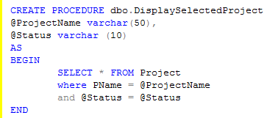


Stored Procedures (with Input Parameters)
Creation:
Execution:

Slide 12
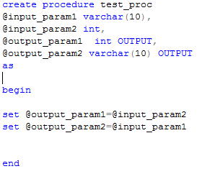
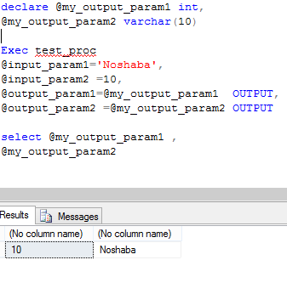
Stored Procedures (with OUTPUT Parameters)
Creation:
Execution:

Slide 13
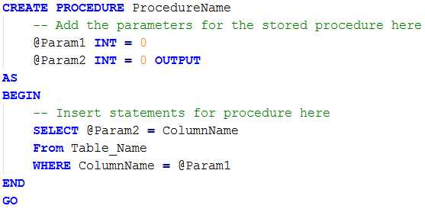
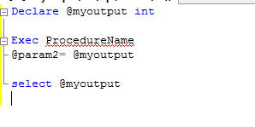
Stored Procedures (Default value of parameter)
Creation:
Execution:

Slide 14
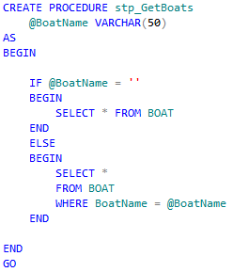
Stored Procedures (IF else Conditions)

